Slide 1
Cartesian Equation of a Line

Slide 2

If the slope of a line is $\frac{b}{a}$, then the direction vector is $\vec{(a,b)}$

Slide 3
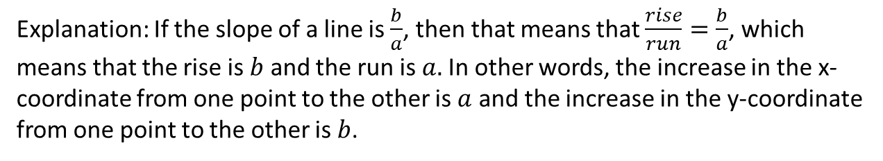

If the slope of a line is $\frac{b}{a}$, then the direction vector is $\vec{(a,b)}$
Explanation: If the slope of a line is $\frac{b}{a}$, then that means that $\frac{rise}{run}=\frac{b}{a}$, which means that the rise is $b$ and the run is $a.$In other words, the increase in the x-coordinate from one point to the other is $a$ and the increase in the y-coordinate from one point to the other is $b$.

Slide 4

If the slope of a line is $\frac{b}{a}$, then the direction vector is $\vec{(a,b)}$
Explanation: If the slope of a line is $\frac{b}{a}$, then that means that $\frac{rise}{run}=\frac{b}{a}$, which means that the rise is $b$ and the run is $a.$In other words, the increase in the x-coordinate from one point to the other is $a$ and the increase in the y-coordinate from one point to the other is $b$.
Therefore, the direction vector is $\vec{(a,b)}$.

Slide 5
If the Cartesian equation of a line is Ax + By + C = 0, then the slope of the line is –A/B.

Slide 6
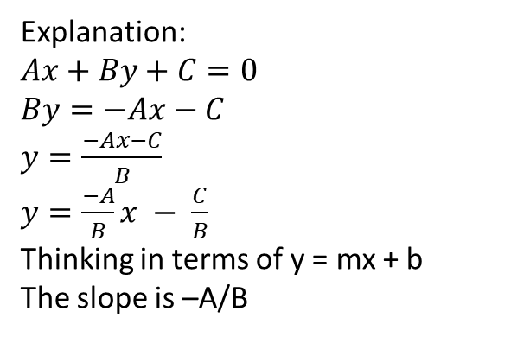
If the Cartesian equation of a line is Ax + By + C = 0, then the slope of the line is –A/B.
Explanation:
$Ax+By+C=0$
$By=−Ax−C$
$y=\frac{−Ax−C}{B}$
$y=\frac{−A}{B}x − \frac{C}{B}$
Thinking in terms of y = mx + b
The slope is –A/B

Slide 7
If Ax + By + C = 0, then the normal vector is (A, B).

Slide 8
If Ax + By + C = 0, then the normal vector is (A, B).
The normal vector refers to the direction vector of a perpendicular line. Normal in this context means perpendicular

Slide 9
If Ax + By + C = 0, then the normal vector is (A, B).
Explanation: We already showed that if Ax + By + C = 0, then the slope of the line is –A/B
This means that the slope of a perpendicular line is the negative reciprocal, which is B/A
If the slope of a line is B/A, then that means when the rise is B, the run is A
This means that for that line, for every increase in the x-coordinate of A, there is an increase in the y-coordinate of B
This means that the direction vector of that perpendicular line is (A, B)
This is the definition of a normal vector; the normal vector is (A, B)

Slide 10
Example
Determine the equivalent vector and parametric equations of the line
y = ¾ x + 2.

Slide 11
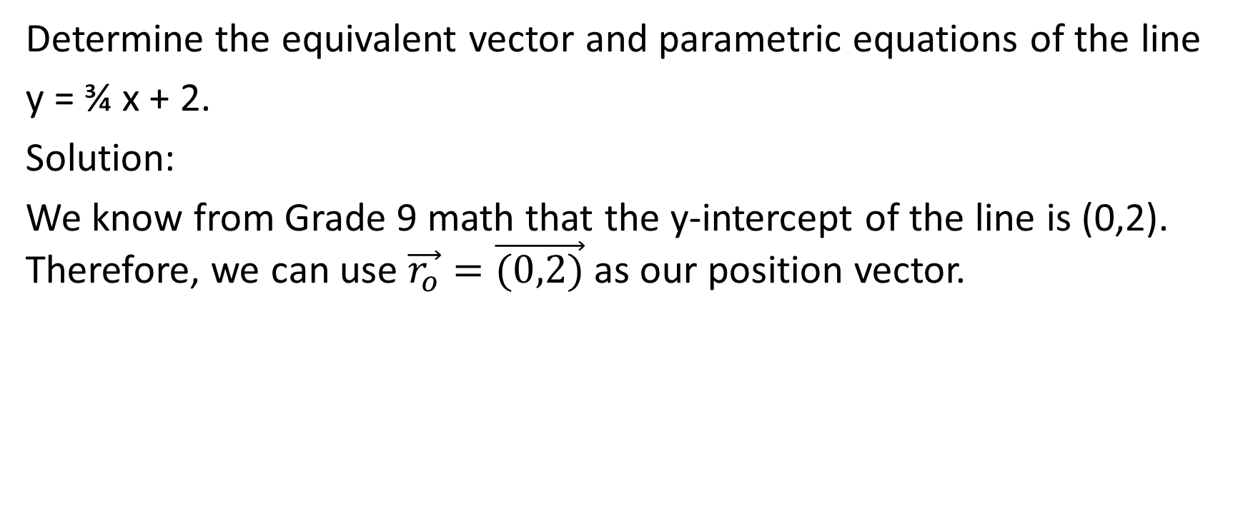
Determine the equivalent vector and parametric equations of the line
y = ¾ x + 2.
Solution:
We know from Grade 9 math that the y-intercept of the line is (0,2). Therefore, we can use $\vec{r_{o}}=\vec{(0,2)}$ as our position vector.

Slide 12
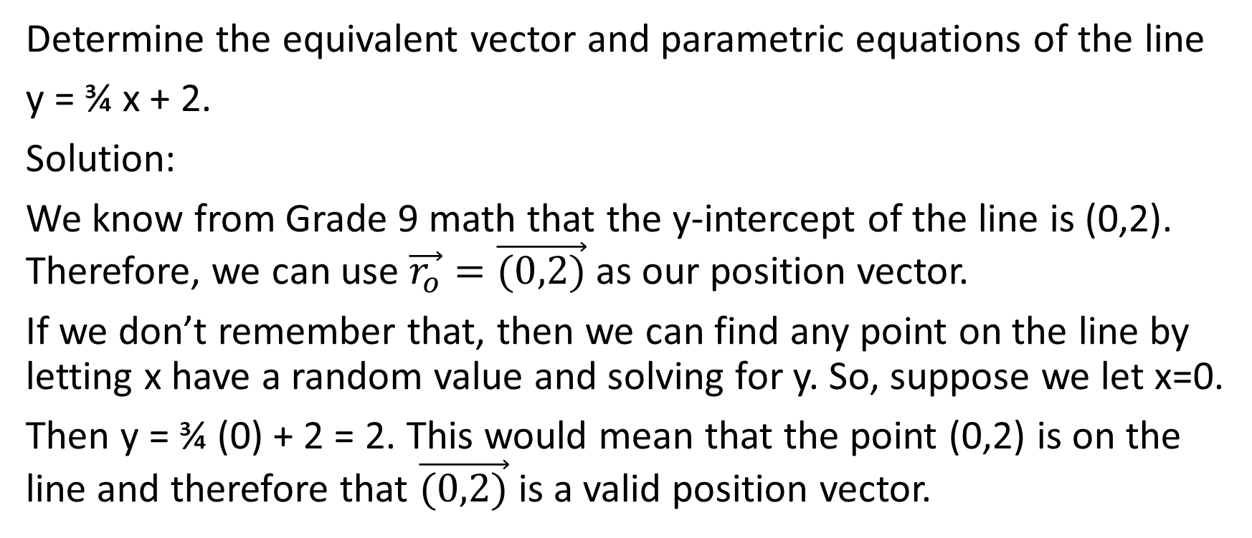
Determine the equivalent vector and parametric equations of the line
y = ¾ x + 2.
Solution:
We know from Grade 9 math that the y-intercept of the line is (0,2). Therefore, we can use $\vec{r_{o}}=\vec{(0,2)}$ as our position vector.
If we don’t remember that, then we can find any point on the line by letting x have a random value and solving for y. So, suppose we let x=0.
Then y = ¾ (0) + 2 = 2. This would mean that the point (0,2) is on the line and therefore that $\vec{(0,2)}$ is a valid position vector.

Slide 13
Determine the equivalent vector and parametric equations of the line
y = ¾ x + 2.
Solution:
Next, we have to find a direction vector.

Slide 14
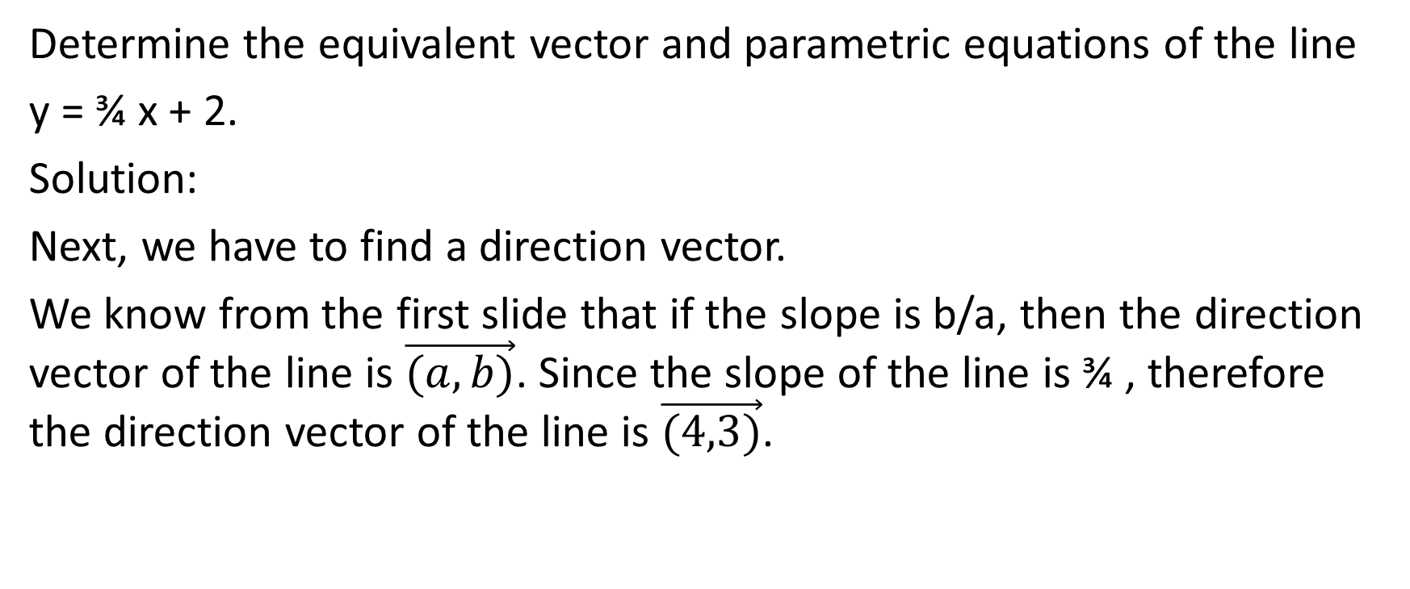
Determine the equivalent vector and parametric equations of the line
y = ¾ x + 2.
Solution:
Next, we have to find a direction vector.
We know from the first slide that if the slope is b/a, then the direction vector of the line is $\vec{(a,b)}$. Since the slope of the line is ¾ , therefore the direction vector of the line is $\vec{(4,3)}$.

Slide 15
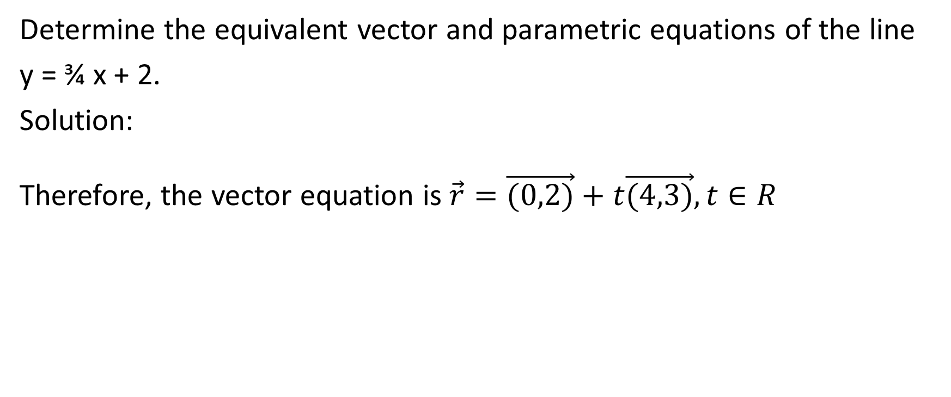
Determine the equivalent vector and parametric equations of the line
y = ¾ x + 2.
Solution:
Therefore, the vector equation is $\vec{r}=\vec{(0,2)}+t\vec{(4,3)}, t∈R$

Slide 16
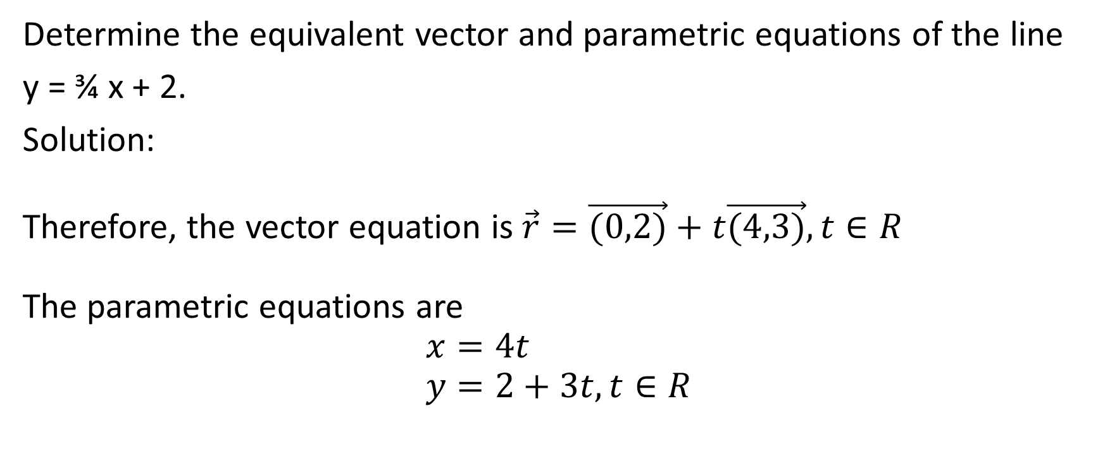
Determine the equivalent vector and parametric equations of the line
y = ¾ x + 2.
Solution:
Therefore, the vector equation is $\vec{r}=\vec{(0,2)}+t\vec{(4,3)}, t∈R$
The parametric equations are
$$x=4t$$
$$y=2+3t, t∈R$$

Slide 17
Example
Given the line r = (3, -6) + s(-1, -4), s ϵ R, determine the equivalent slope y-intercept form and Cartesian equation.

Slide 18
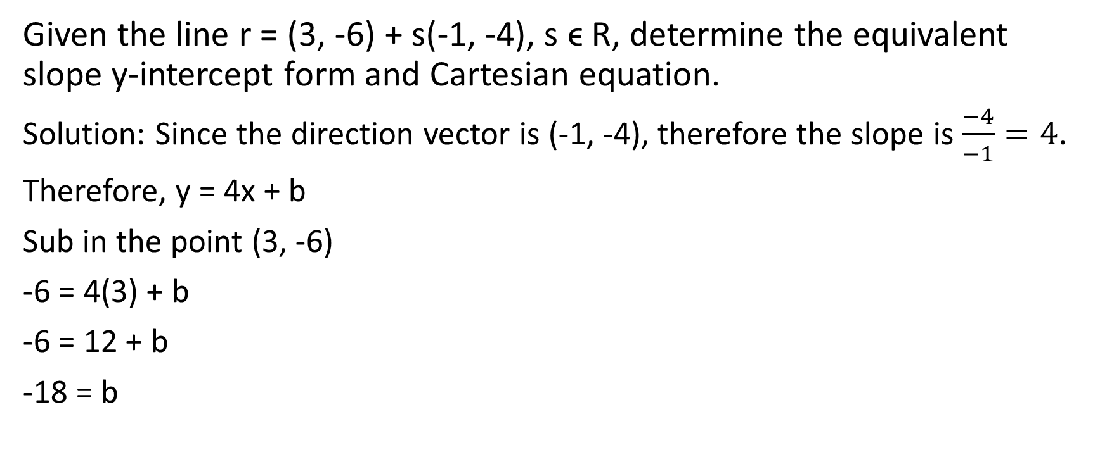
Given the line r = (3, -6) + s(-1, -4), s ϵ R, determine the equivalent slope y-intercept form and Cartesian equation.
Solution: Since the direction vector is (-1, -4), therefore the slope is $\frac{−4}{−1}=4$.
Therefore, y = 4x + b
Sub in the point (3, -6)
-6 = 4(3) + b
-6 = 12 + b
-18 = b
Therefore the slope y-intercept form of the line is y = 4x – 18 .

Slide 19
Given the line r = (3, -6) + s(-1, -4), s ϵ R, determine the equivalent slope y-intercept form and Cartesian equation.
Solution: Now we want to find the Cartesian equation.
Since the direction vector is (-1, -4), therefore the normal vector is (4, -1)
This means that the Cartesian equation of the line is 4x – 1y + C = 0
Now we can sub in any point on the line, so we will use (3, -6)
4(3) – 1(-6) + C = 0
12 + 6 + C = 0
C = -18
Therefore the Cartesian equation of the line is 4x – y – 18 = 0

Slide 20
Example
Determine the Cartesian equation of the line passing through A (4, -2) that has the vector (5,3) as its normal.

Slide 21
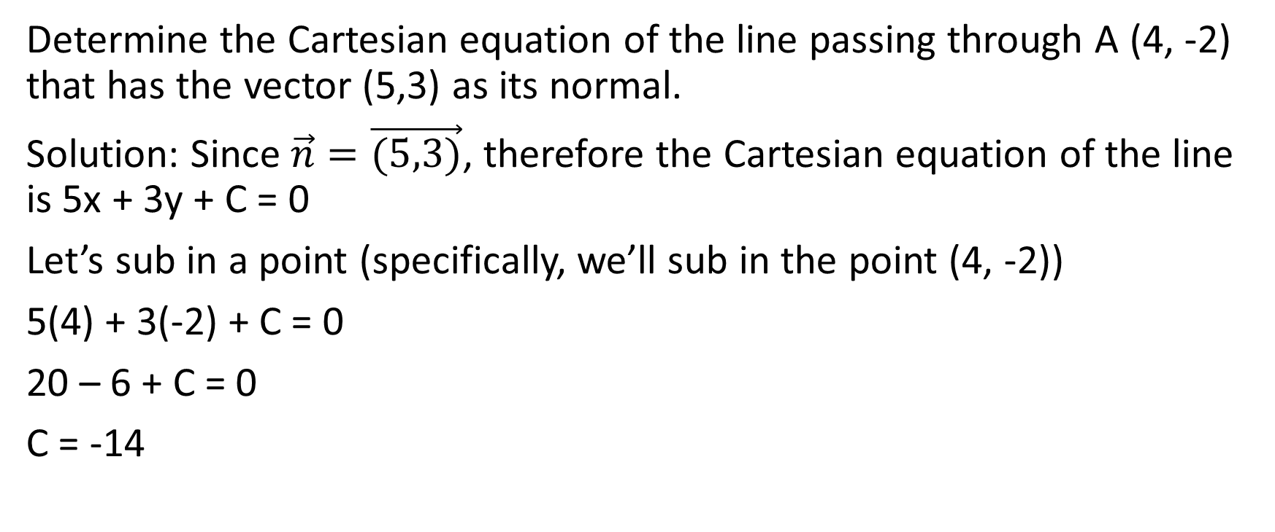
Determine the Cartesian equation of the line passing through A (4, -2) that has the vector (5,3) as its normal.
Solution: Since $\vec{n}=\vec{(5,3)}$, therefore the Cartesian equation of the line is 5x + 3y + C = 0
Let’s sub in a point (specifically, we’ll sub in the point (4, -2))
5(4) + 3(-2) + C = 0
20 – 6 + C = 0
C = -14
Therefore the Cartesian equation of the line is 5x + 3y – 14 = 0

Slide 22
Example
For what value of k are the line
kx + 4y – 4 = 0 and 3x – 2y – 3 = 0 perpendicular?

Slide 23
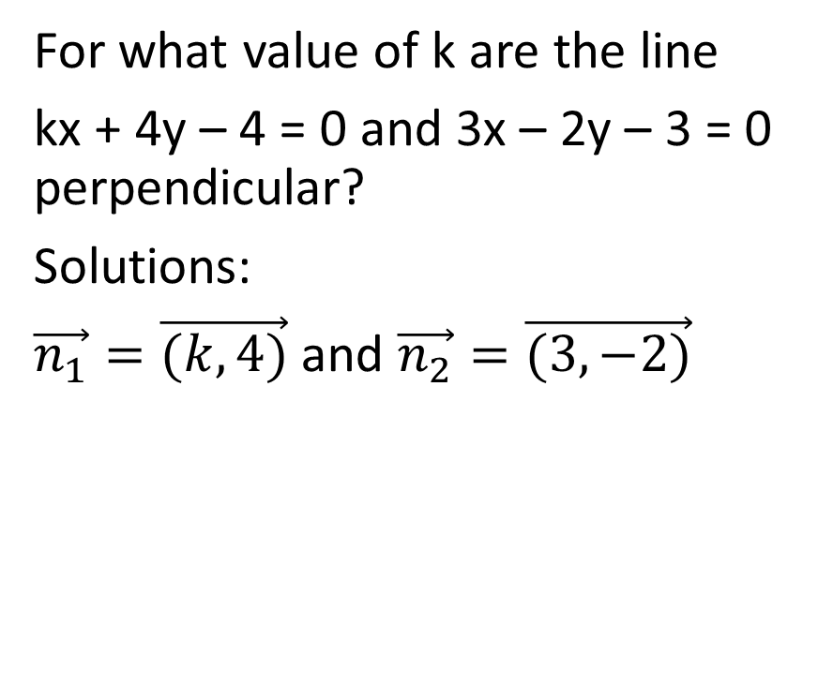
For what value of k are the line
kx + 4y – 4 = 0 and 3x – 2y – 3 = 0 perpendicular?
Solutions:
$\vec{n_{1}}=\vec{(k,4)}$ and $\vec{n_{2}}=\vec{(3,−2)}$

Slide 24
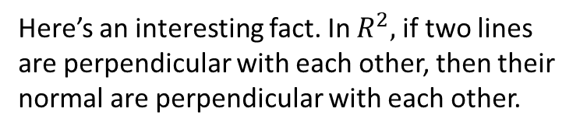
For what value of k are the line
kx + 4y – 4 = 0 and 3x – 2y – 3 = 0 perpendicular?
Solutions:
$\vec{n_{1}}=\vec{(k,4)}$ and $\vec{n_{2}}=\vec{(3,−2)}$
Here’s an interesting fact. In $R^{2},$if two lines are perpendicular with each other, then their normal are perpendicular with each other.

Slide 25
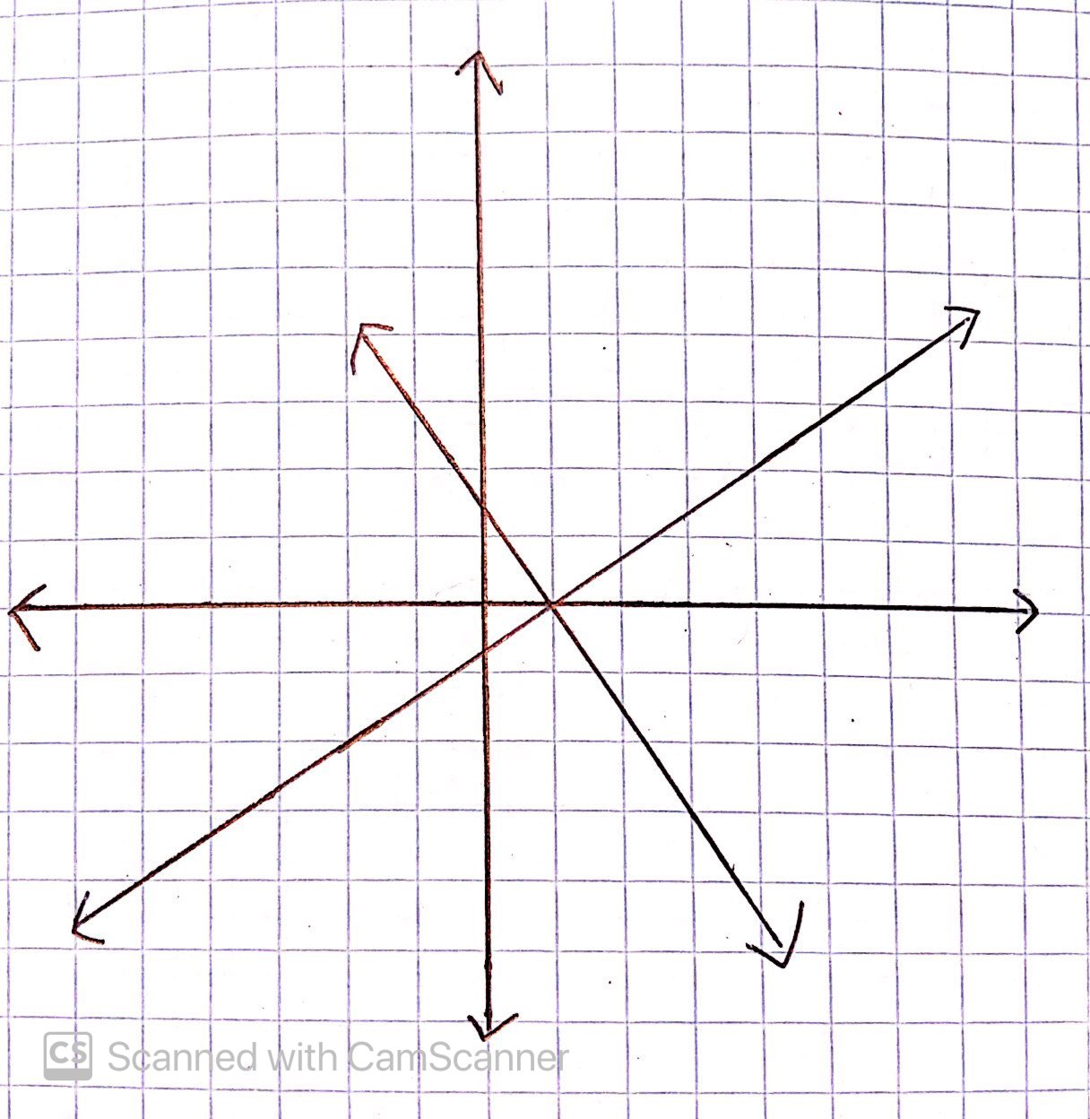
For what value of k are the line
kx + 4y – 4 = 0 and 3x – 2y – 3 = 0 perpendicular?
Solutions:
$\vec{n_{1}}=\vec{(k,4)}$ and $\vec{n_{2}}=\vec{(3,−2)}$
Here are two perpendicular lines.

Slide 26
For what value of k are the line
kx + 4y – 4 = 0 and 3x – 2y – 3 = 0 perpendicular?
Solutions:
$\vec{n_{1}}=\vec{(k,4)}$ and $\vec{n_{2}}=\vec{(3,−2)}$
Here are two perpendicular lines.
We can draw the normal for each

Slide 27
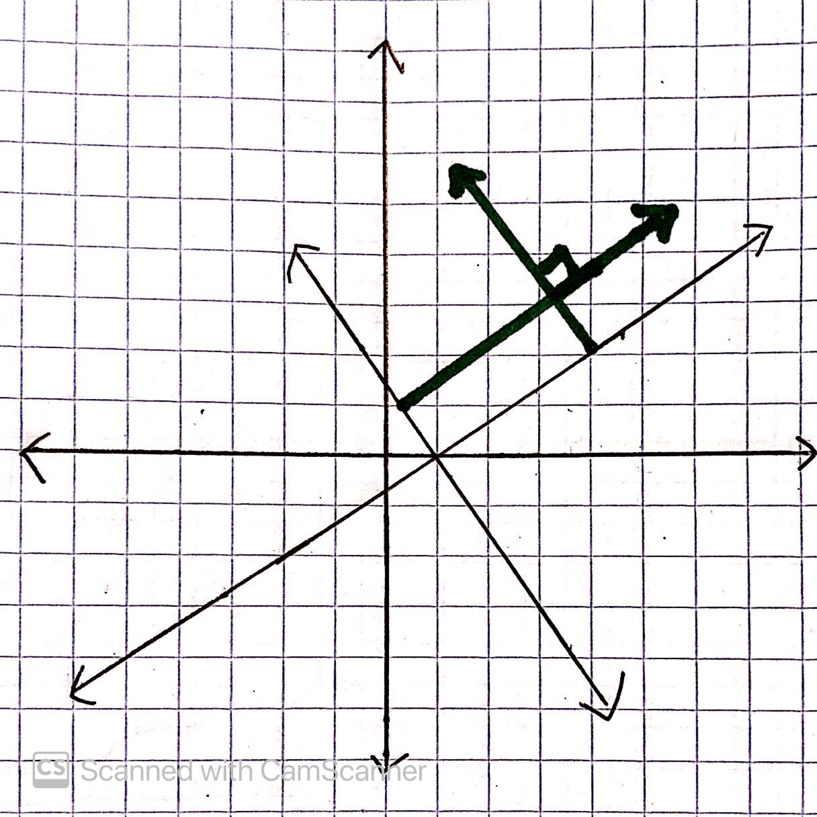
For what value of k are the line
kx + 4y – 4 = 0 and 3x – 2y – 3 = 0 perpendicular?
Solutions:
$\vec{n_{1}}=\vec{(k,4)}$ and $\vec{n_{2}}=\vec{(3,−2)}$
And we see that the normal vectors are perpendicular to each other.

Slide 28
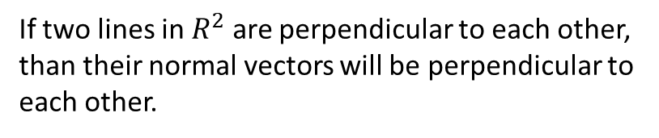
For what value of k are the line
kx + 4y – 4 = 0 and 3x – 2y – 3 = 0 perpendicular?
Solutions:
$\vec{n_{1}}=\vec{(k,4)}$ and $\vec{n_{2}}=\vec{(3,−2)}$
If two lines in $R^{2}$ are perpendicular to each other, than their normal vectors will be perpendicular to each other.

Slide 29
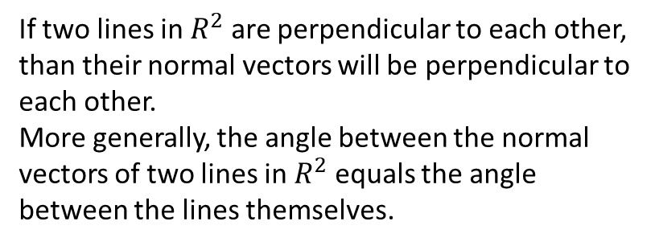
For what value of k are the line
kx + 4y – 4 = 0 and 3x – 2y – 3 = 0 perpendicular?
Solutions:
$\vec{n_{1}}=\vec{(k,4)}$ and $\vec{n_{2}}=\vec{(3,−2)}$
If two lines in $R^{2}$ are perpendicular to each other, than their normal vectors will be perpendicular to each other.
More generally, the angle between the normal vectors of two lines in $R^{2}$ equals the angle between the lines themselves.

Slide 30
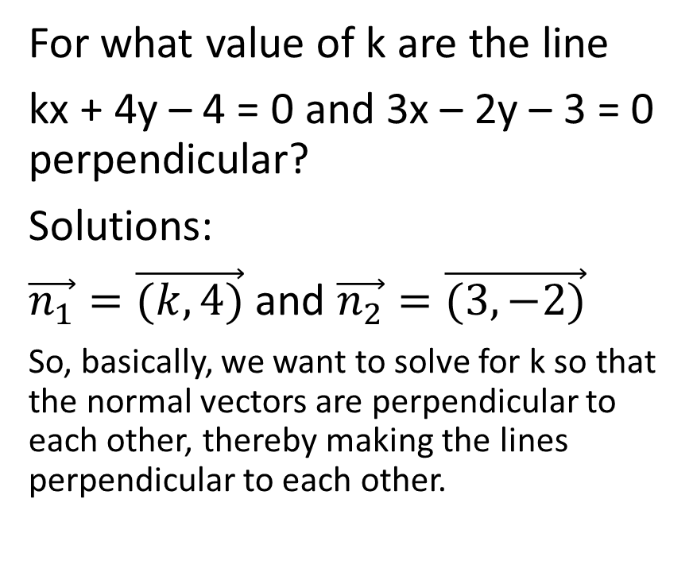
For what value of k are the line
kx + 4y – 4 = 0 and 3x – 2y – 3 = 0 perpendicular?
Solutions:
$\vec{n_{1}}=\vec{(k,4)}$ and $\vec{n_{2}}=\vec{(3,−2)}$
So, basically, we want to solve for k so that the normal vectors are perpendicular to each other, thereby making the lines perpendicular to each other.
If the normal vectors are perpendicular to each other, than their dot product should equal 0

Slide 31
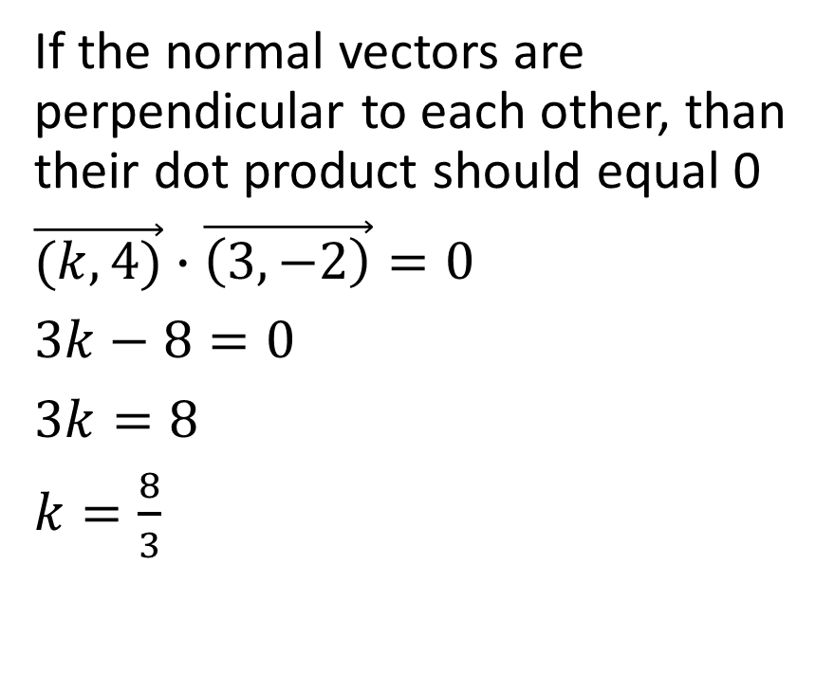
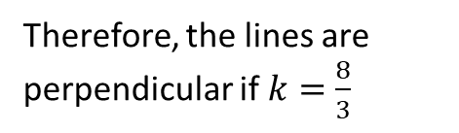
For what value of k are the line
kx + 4y – 4 = 0 and 3x – 2y – 3 = 0 perpendicular?
Solutions:
$\vec{n_{1}}=\vec{(k,4)}$ and $\vec{n_{2}}=\vec{(3,−2)}$
So, basically, we want to solve for k so that the normal vectors are perpendicular to each other, thereby making the lines perpendicular to each other.
If the normal vectors are perpendicular to each other, than their dot product should equal 0
$\vec{(k,4)}∙\vec{\left(3,−2\right)}=0$
$3k−8=0$
$3k=8$
$k=\frac{8}{3}$
Therefore, the lines are perpendicular if $k=\frac{8}{3}$

Slide 32
Example
Determine the acute angle formed at the intersection of the following pair of lines.
L₁: (x,y) = (2,2) + s(-1, 3) and L₂: (x,y) = (5,1) + t (3,4)

Slide 33
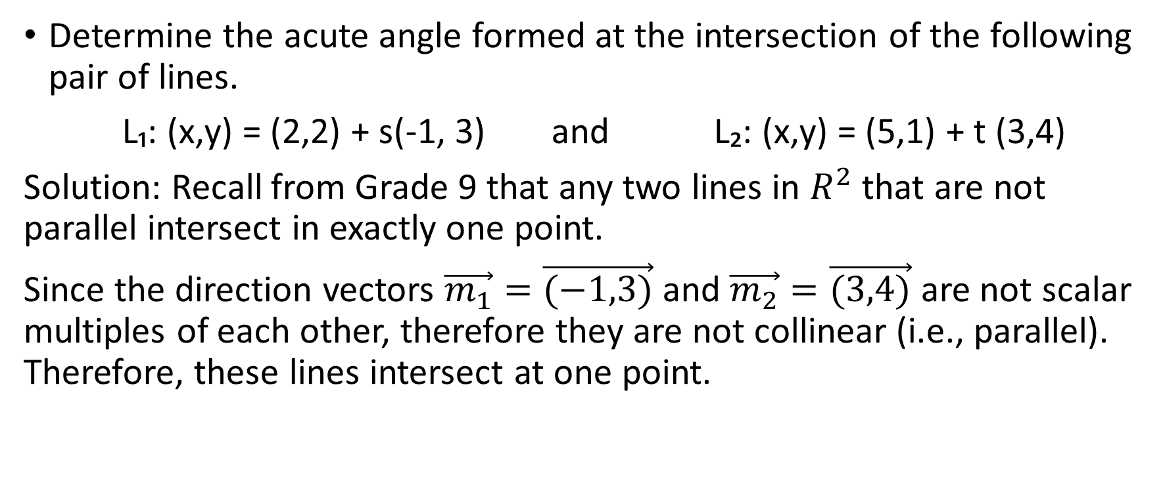
Determine the acute angle formed at the intersection of the following pair of lines.
L₁: (x,y) = (2,2) + s(-1, 3) and L₂: (x,y) = (5,1) + t (3,4)
Solution: Recall from Grade 9 that any two lines in $R^{2}$ that are not parallel intersect in exactly one point.
Since the direction vectors $\vec{m_{1}}=\vec{(−1,3)}$ and $\vec{m_{2}}=\vec{(3,4)}$ are not scalar multiples of each other, therefore they are not collinear (i.e., parallel). Therefore, these lines intersect at one point.

Slide 34
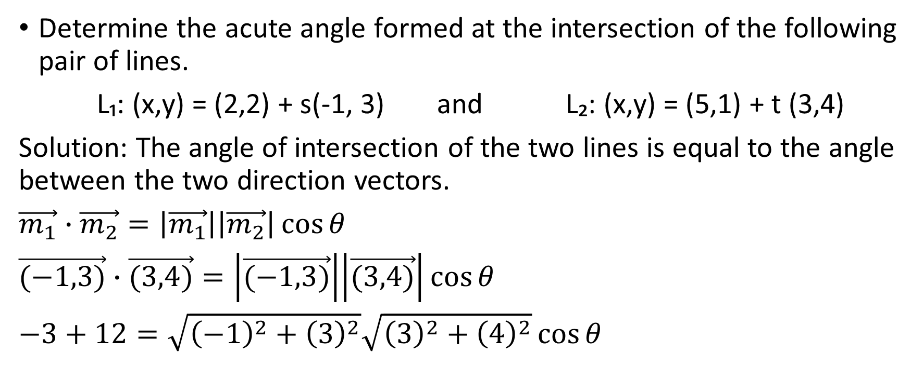
Determine the acute angle formed at the intersection of the following pair of lines.
L₁: (x,y) = (2,2) + s(-1, 3) and L₂: (x,y) = (5,1) + t (3,4)
Solution: The angle of intersection of the two lines is equal to the angle between the two direction vectors.
$\vec{m_{1}}∙\vec{m_{2}}=\left|\vec{m_{1}}\right|\left|\vec{m_{2}}\right|\cos{θ}$
$\vec{(−1,3)}∙\vec{(3,4)}=\left|\vec{(−1,3)}\right|\left|\vec{(3,4)}\right|\cos{θ}$
$−3+12=\sqrt{{\left(−1\right)}^{2}+{\left(3\right)}^{2}}\sqrt{{\left(3\right)}^{2}+{\left(4\right)}^{2}}\cos{θ}$

Slide 35
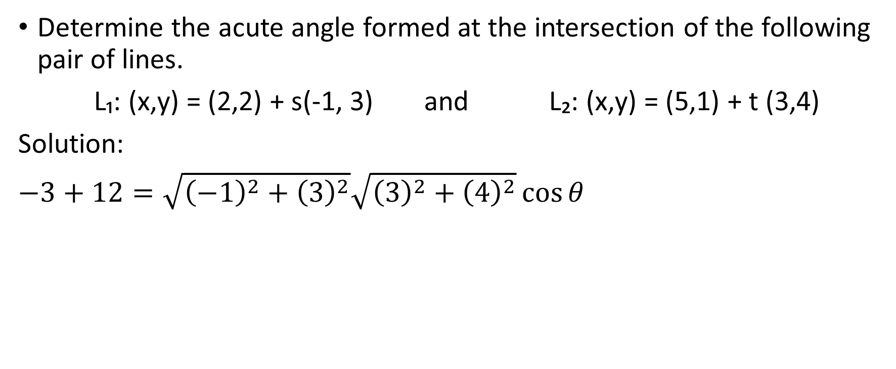
Determine the acute angle formed at the intersection of the following pair of lines.
L₁: (x,y) = (2,2) + s(-1, 3) and L₂: (x,y) = (5,1) + t (3,4)
Solution:
$−3+12=\sqrt{{\left(−1\right)}^{2}+{\left(3\right)}^{2}}\sqrt{{\left(3\right)}^{2}+{\left(4\right)}^{2}}\cos{θ}$

Slide 36

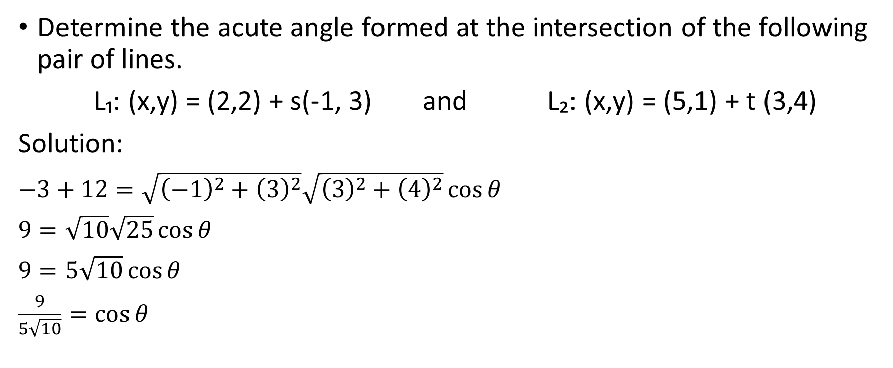
Determine the acute angle formed at the intersection of the following pair of lines.
L₁: (x,y) = (2,2) + s(-1, 3) and L₂: (x,y) = (5,1) + t (3,4)
Solution:
$−3+12=\sqrt{{\left(−1\right)}^{2}+{\left(3\right)}^{2}}\sqrt{{\left(3\right)}^{2}+{\left(4\right)}^{2}}\cos{θ}$
$9=\sqrt{10}\sqrt{25}\cos{θ}$
$9=5\sqrt{10}\cos{θ}$
$\frac{9}{5\sqrt{10}}=\cos{θ}$
$$θ≅{55.3}^{0}$$

Slide 37


Determine the acute angle formed at the intersection of the following pair of lines.
L₁: (x,y) = (2,2) + s(-1, 3) and L₂: (x,y) = (5,1) + t (3,4)
Solution:
It’s good to remember that if two lines meet at an acute angle, that there is also an acute angle there.

Slide 38
Determine the acute angle formed at the intersection of the following pair of lines.
L₁: (x,y) = (2,2) + s(-1, 3) and L₂: (x,y) = (5,1) + t (3,4)
Solution:
In this case, the acute angle is approximately 55.3° and the obtuse angle is approximately 180° - 55.3° = 126.7°. The question only asked for the acute angle though, so our final answer is
The acute angle made between the two lines is approximately 55.3°

Slide 39
Example
Determine the acute and obtuse angle between the lines
3x – 2y + 7 = 0 and x + 4y – 17 = 0

Slide 40
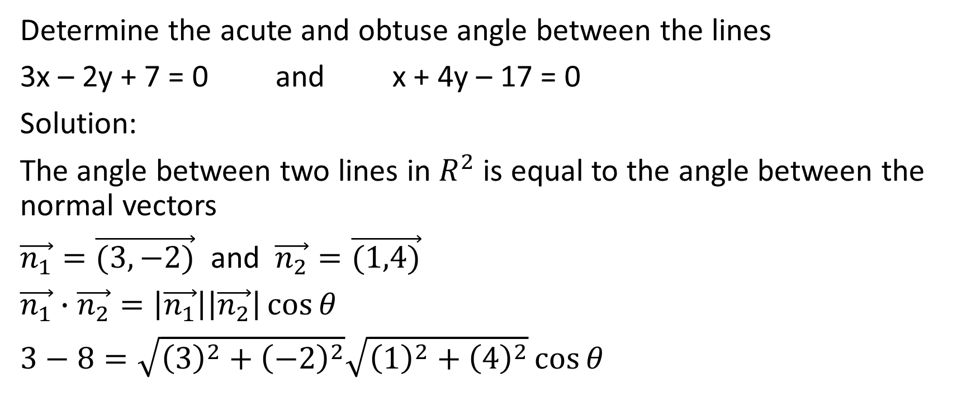
Determine the acute and obtuse angle between the lines
3x – 2y + 7 = 0 and x + 4y – 17 = 0
Solution:
The angle between two lines in $R^{2}$ is equal to the angle between the normal vectors
$\vec{n_{1}}=\vec{(3,−2)}$ and $\vec{n_{2}}=\vec{(1,4)}$
$\vec{n_{1}}∙\vec{n_{2}}=\left|\vec{n_{1}}\right|\left|\vec{n_{2}}\right|\cos{θ}$
$3−8=\sqrt{{\left(3\right)}^{2}+{\left(−2\right)}^{2}}\sqrt{{\left(1\right)}^{2}+{\left(4\right)}^{2}}\cos{θ}$

Slide 41

Determine the acute and obtuse angle between the lines
3x – 2y + 7 = 0 and x + 4y – 17 = 0
Solution:
$3−8=\sqrt{{\left(3\right)}^{2}+{\left(−2\right)}^{2}}\sqrt{{\left(1\right)}^{2}+{\left(4\right)}^{2}}\cos{θ}$

Slide 42
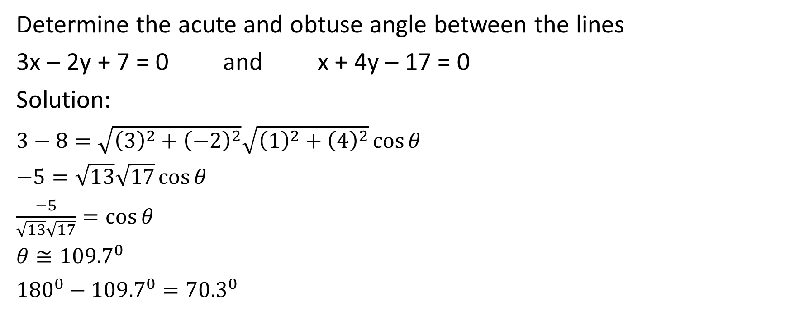
Determine the acute and obtuse angle between the lines
3x – 2y + 7 = 0 and x + 4y – 17 = 0
Solution:
$3−8=\sqrt{{\left(3\right)}^{2}+{\left(−2\right)}^{2}}\sqrt{{\left(1\right)}^{2}+{\left(4\right)}^{2}}\cos{θ}$
$−5=\sqrt{13}\sqrt{17}\cos{θ}$
$\frac{−5}{\sqrt{13}\sqrt{17}}=\cos{θ}$
$θ≅{109.7}^{0}$
${180}^{0}−{109.7}^{0}={70.3}^{0}$

Slide 43
Determine the acute and obtuse angle between the lines
3x – 2y + 7 = 0 and x + 4y – 17 = 0
Solution:
$3−8=\sqrt{{\left(3\right)}^{2}+{\left(−2\right)}^{2}}\sqrt{{\left(1\right)}^{2}+{\left(4\right)}^{2}}\cos{θ}$
$−5=\sqrt{13}\sqrt{17}\cos{θ}$
$\frac{−5}{\sqrt{13}\sqrt{17}}=\cos{θ}$
$θ≅{109.7}^{0}$
${180}^{0}−{109.7}^{0}={70.3}^{0}$
Therefore the acute angle between the lines is approximately 70.3° and the obtuse angle between the lines is approximately 109.7°

Slide 44

Example
The line segment joining A(2, 0) and B(5,3) is the hypotenuse of a right triangle. The third vertex, C, lies on the line $\vec{r}=\vec{(3,1)}+t\vec{(1,−2)}$. Determine the coordinates of C (there might be more than one answer)

Slide 45
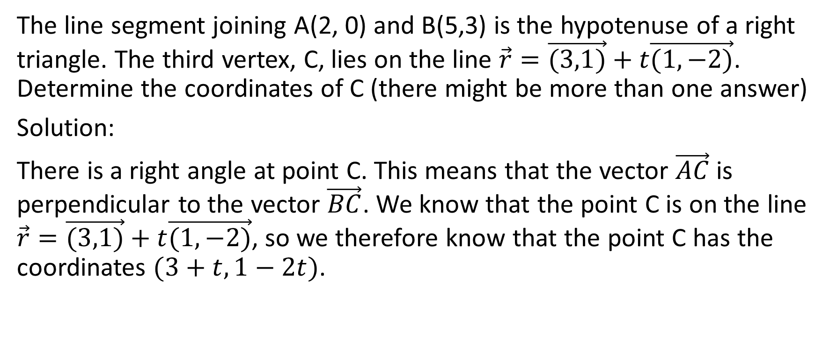
The line segment joining A(2, 0) and B(5,3) is the hypotenuse of a right triangle. The third vertex, C, lies on the line $\vec{r}=\vec{(3,1)}+t\vec{(1,−2)}$. Determine the coordinates of C (there might be more than one answer)
Solution:
There is a right angle at point C. This means that the vector $\vec{AC}$ is perpendicular to the vector $\vec{BC}$. We know that the point C is on the line $\vec{r}=\vec{(3,1)}+t\vec{(1,−2)}$, so we therefore know that the point C has the coordinates $(3+t,1−2t)$.

Slide 46
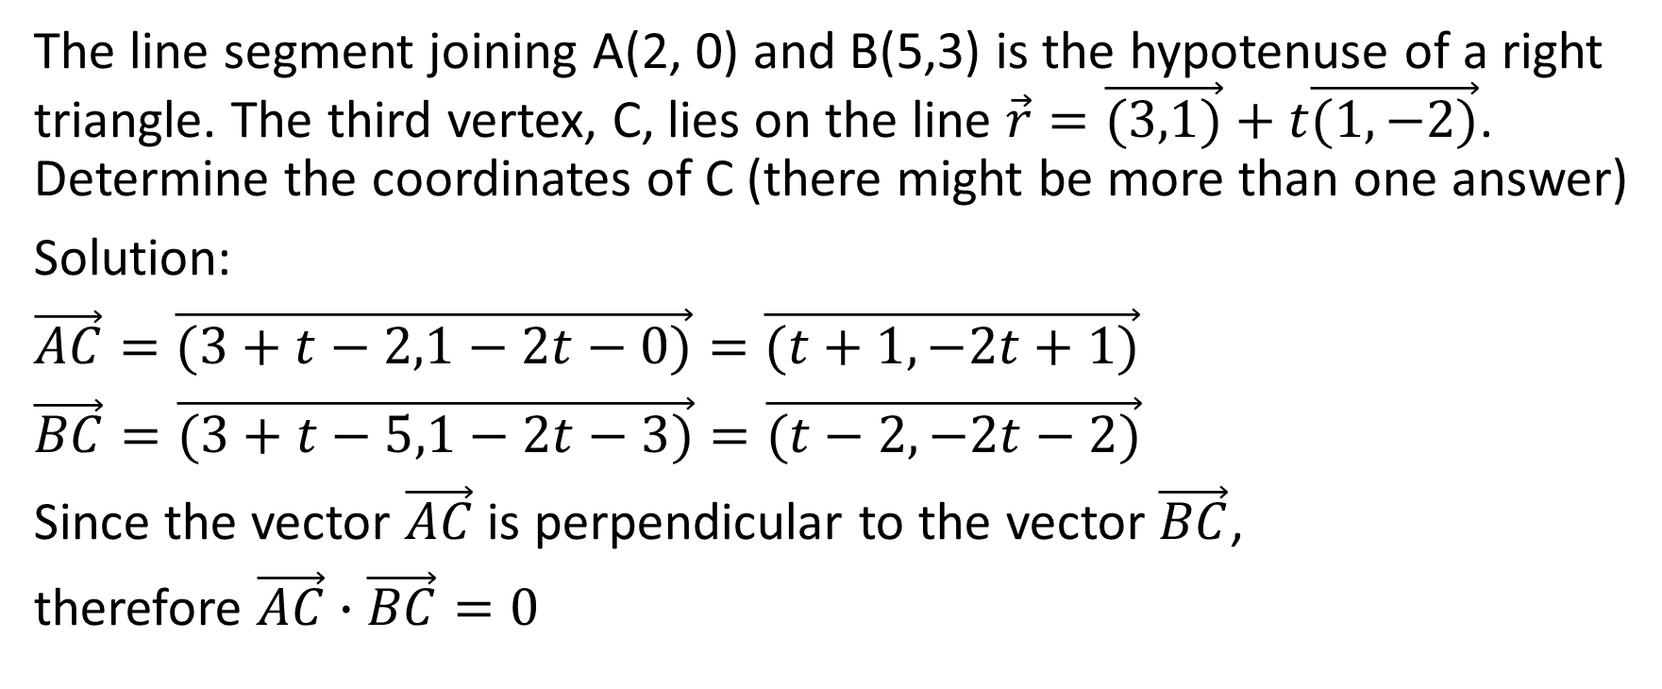
The line segment joining A(2, 0) and B(5,3) is the hypotenuse of a right triangle. The third vertex, C, lies on the line $\vec{r}=\vec{(3,1)}+t\vec{(1,−2)}$. Determine the coordinates of C (there might be more than one answer)
Solution:
$\vec{AC}=\vec{(3+t−2,1−2t−0)}=\vec{(t+1,−2t+1)}$
$\vec{BC}=\vec{(3+t−5,1−2t−3)}=\vec{(t−2,−2t−2)}$
Since the vector $\vec{AC}$ is perpendicular to the vector $\vec{BC}$,
therefore $\vec{AC}∙\vec{BC}=0$

Slide 47
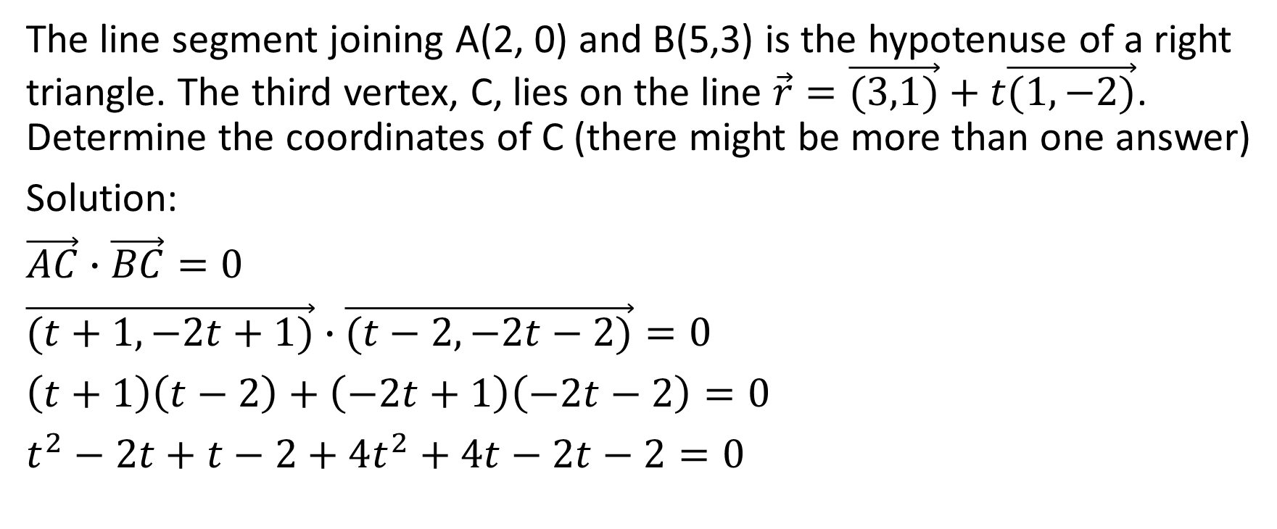
The line segment joining A(2, 0) and B(5,3) is the hypotenuse of a right triangle. The third vertex, C, lies on the line $\vec{r}=\vec{(3,1)}+t\vec{(1,−2)}$. Determine the coordinates of C (there might be more than one answer)
Solution:
$\vec{AC}∙\vec{BC}=0$
$\vec{(t+1,−2t+1)}∙$ $\vec{(t−2,−2t−2)}=0$
$\left(t+1\right)\left(t−2\right)+\left(−2t+1\right)\left(−2t−2\right)=0$
$t^{2}−2t+t−2+4t^{2}+4t−2t−2=0$

Slide 48
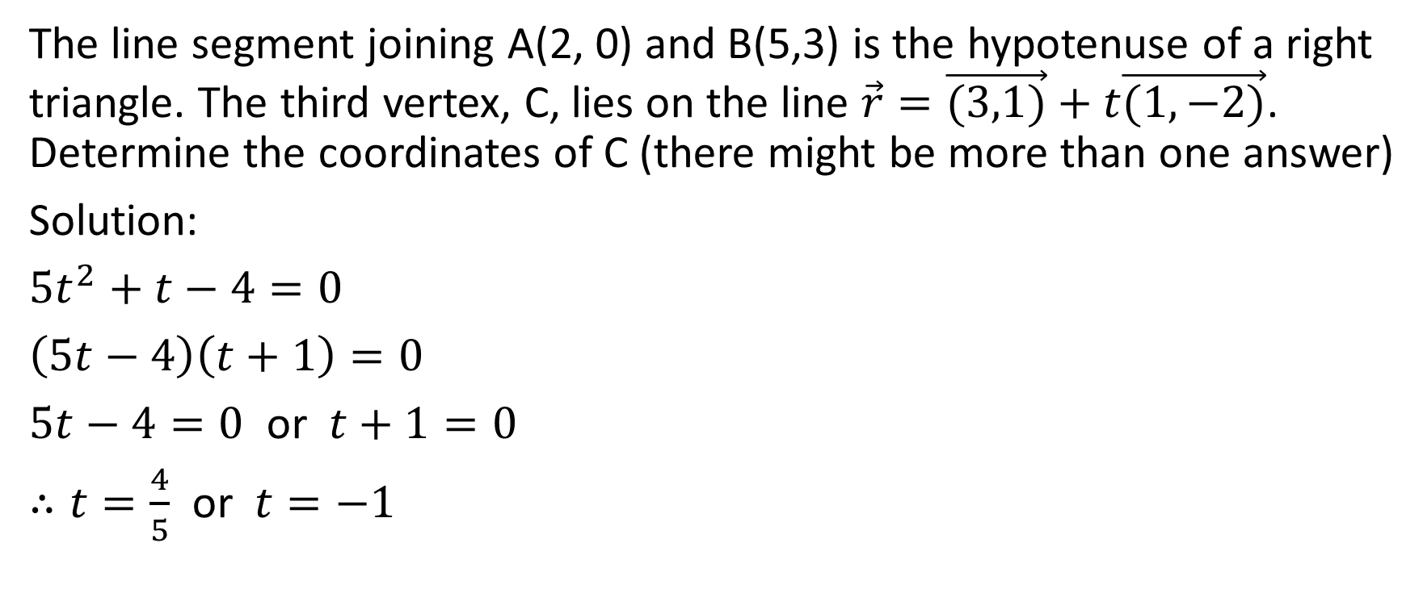
The line segment joining A(2, 0) and B(5,3) is the hypotenuse of a right triangle. The third vertex, C, lies on the line $\vec{r}=\vec{(3,1)}+t\vec{(1,−2)}$. Determine the coordinates of C (there might be more than one answer)
Solution:
$5t^{2}+t−4=0$
$\left(5t−4\right)\left(t+1\right)=0$
$5t−4=0$ or $t+1=0$
$∴t=\frac{4}{5}$ or $t=−1$

Slide 49
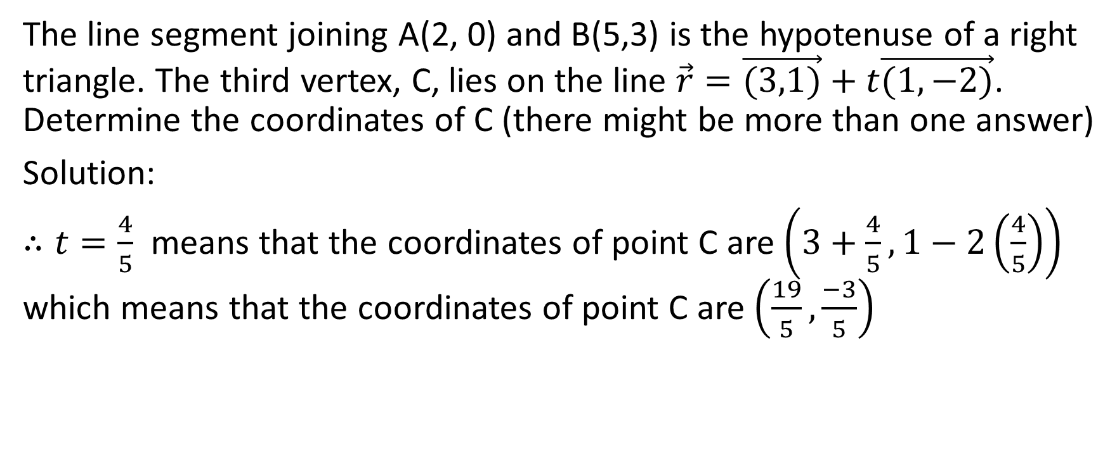
The line segment joining A(2, 0) and B(5,3) is the hypotenuse of a right triangle. The third vertex, C, lies on the line $\vec{r}=\vec{(3,1)}+t\vec{(1,−2)}$. Determine the coordinates of C (there might be more than one answer)
Solution:
$∴t=\frac{4}{5}$ means that the coordinates of point C are $\left(3+\frac{4}{5},1−2\left(\frac{4}{5}\right)\right)$ which means that the coordinates of point C are $\left(\frac{19}{5},\frac{−3}{5}\right)$

Slide 50
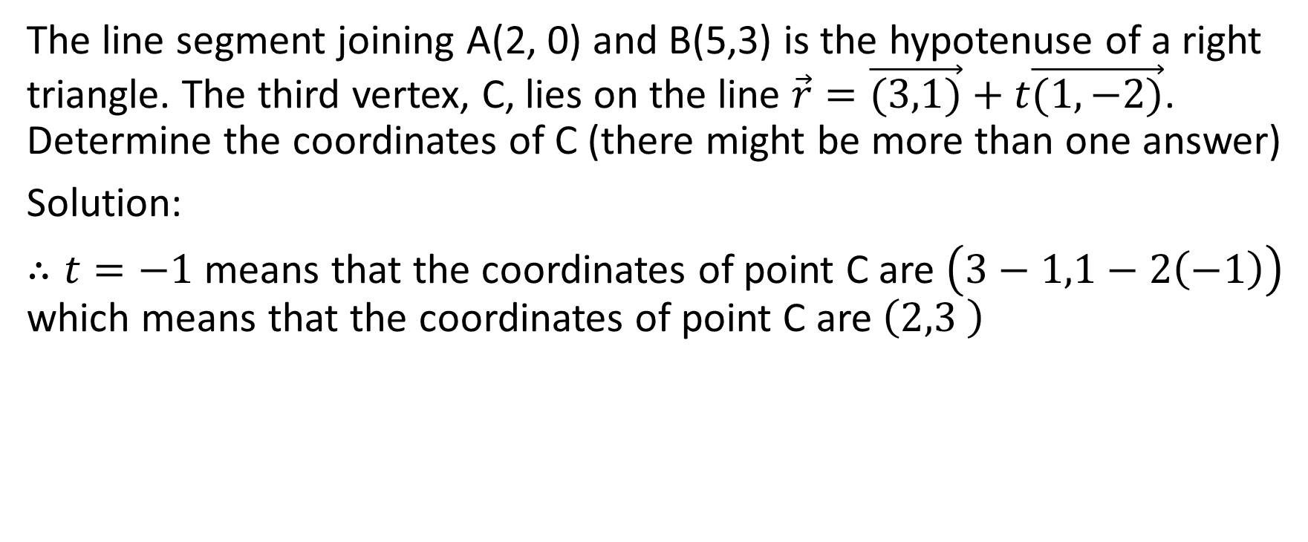
The line segment joining A(2, 0) and B(5,3) is the hypotenuse of a right triangle. The third vertex, C, lies on the line $\vec{r}=\vec{(3,1)}+t\vec{(1,−2)}$. Determine the coordinates of C (there might be more than one answer)
Solution:
$∴t=−1$ means that the coordinates of point C are $\left(3−1,1−2\left(−1\right)\right)$ which means that the coordinates of point C are $\left(2,3 \right)$

Slide 51
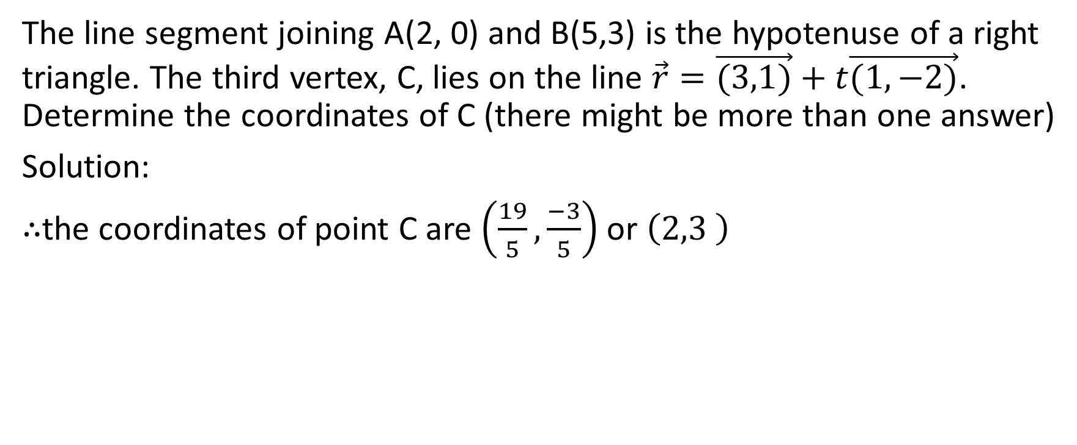
The line segment joining A(2, 0) and B(5,3) is the hypotenuse of a right triangle. The third vertex, C, lies on the line $\vec{r}=\vec{(3,1)}+t\vec{(1,−2)}$. Determine the coordinates of C (there might be more than one answer)
Solution:
$∴$the coordinates of point C are $\left(\frac{19}{5},\frac{−3}{5}\right)$ or $\left(2,3 \right)$

